Slide 1
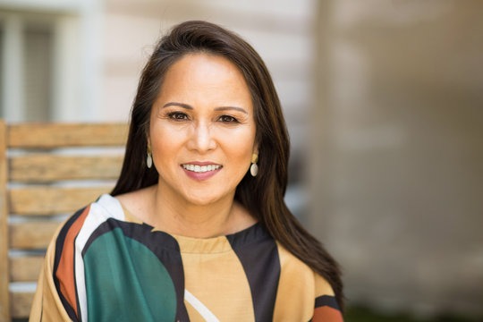
“I have a busy lifestyle and my family means everything to me. We enjoy going to the movies on the weekends, but getting tickets is a hassle now."
Add image that represents this persona
Goals
Earn a promotion to become a Senior Accountant II
File LLC to open on company and do private consultations
Continue to provide for her family and enjoy the experience of going to the movies.
Frustrations
”Every time I try to get tickets online for the movies it is difficult." I’m not sure which movies I can take my kids with me to, and where I can sit.”
“I want to be able to choose the type of viewing experience as well.”
Name: Akira Wang
Age:
Education:
Hometown:
Family:
Occupation:
42
Masters in Accounting San Diego, California
Married, 2 Kids, 1 dog
Senior Accountant at Accounting Firm
Akira is a Senior Accountant at her Accounting Firm in San Diego. Often times she spends long ours at the office to make sure that everything is going as it should, and always lending a helping hand. She wants more out of her career and is building a LLC to consult clients on the side with. Her family however is her top priority. Akira has a 8 year old boy and a 6 year old girl that her and husband are raising. With her busy schedule, she wants to make sure that she can have a good experience with her kids at the movies but she always seems to run into problems at the mobile ticketing app. Most of the time she isn’t sure on where to go to get the tickets, what movies are age appropriate for her children, and what seats she will be able to select.

Slide 2

“Going to see the latest movies is something that I love to do, but I just don’t seem to have time to go and it’s expensive.”
Add image that represents this persona
Goals
Finish Highschool and receive a scholarship for Track and Field to a 4 year university
Save up as much money as I can while I am in school
Find time to enjoy and reflect
Enjoy my hobby as a movie enthusiast
Frustrations
“The movies that I want to see are never at the times I can go see them.”
“The tickets for movies now are pricier than I would like.”
”Some movies I want to see now but I know I’m not old enough”
“Due to the pandemic, I’m not sure which theaters are still open.”
Name: Amber Johnson
Age:
Education:
Hometown:
Family:
Occupation:
17
High School Senior Durham, North Carolina Relationship
Student and Cashier at Best Buy
Amber enjoys spending time after school participating on her varsity Track and Field team. She aims to get a scholarship so that she can attend UNC-chapel Hill and stay close to her family. On the weekends Amber and her boyfriend enjoy going to the movies when she isn’t working. She currently stays with her family in Durham. Amber is tech savy and enjoys getting them in advanced versus getting them at the theatre. However, when she tries to get tickets she wish there were more options and choices to accommodate the showings of the movies, what movie theatres are open, and other components as well.

